Slide 2
How I built cloudskew.com on Azure
@MithunShanbhag

Slide 3

Mithun Shanbhag
Consulting:
Azure, .NET, Angular
CTO, Architect, Developer Services
Building micro-SaaS:
cloudskew.com
quiz.konfhub.com
and more…..
Ex Microsoft
Windows Server, CLR, Visual Studio, Azure
Twitter: @MithunShanbhag

Slide 4
CloudSkew?
Online diagram editor
Cloud architecture diagrams
Free
Almost 120K+ users
Disclaimers (patents, roadmap discussions)

Slide 5
CloudSkew demo

Slide 6
Playbook for Prototypes, POCs, MVPs
Prefer PaaS/Serverless over IaaS
Pay as you go
No server management overhead
Prefer microservices over monoliths
Independent units of scaling and deployment
Release frequently
Goal: idea -> development -> deployment -> release
Ok if UI is not 100% polished or aesthetic
Stable, “it just works” infrastructure
Automated provisioning, scaling, monitoring/alerts.
Stable infra helps maintain the core focus on user-facing features.
No premature optimizations

Slide 7
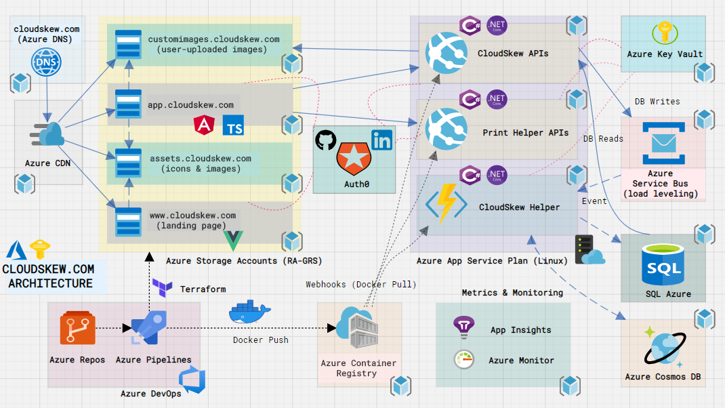
CloudSkew Architecture

Slide 8
Why Microservices?
Independent units of
Deployment
Scaling

Slide 9
Why Serverless + PaaS (instead of IaaS)?
Zero server management overhead.
Intelligent built-in defaults (load-balancing, firewall etc).
Auto-scaling.

Slide 10
One repository per app (microservice)
Deploy app to both test & prod environments from that repository.
[BAD] Deploy app to test & prod environments from different repositories.
[BAD] One repository for all apps.

Slide 11
Package management
[BAD] Code duplication.
Use package registries (NPM, Nuget etc) to share common, reusable code between apps.
[BAD] Always installing latest package version during build.
Use pinned package versions to avoid unexpected/breaking changes.

Slide 12
Externalized configuration (controllability)
[BAD] Coupling an app and its configuration together.
[BAD] Putting passwords, connection strings, endpoint URLs in source control.
Store configuration in an external, secure, centralized key/value store (e.g. Azure KeyVault).
Key names remain same in all dev/test/prod environment, but values change.
RBAC’ed access for app identity.

Slide 13
Self-bootstrapping microservices
[BAD] Running scripts or CLI commands to start up and configure an already deployed app.
Deployed app should know how to start itself up.
Deployed app should know how to configure itself (after reading from external config).
Fast startup, graceful shutdown.
Verbose logs otherwise.

Slide 14
Asynchronous, loosely-coupled microservices
Communication using service bus or GRPC.
Service bus
Dead lettering
Poison messages
Auto-scaled competing consumers
Retries / back-offs / timeouts / circuit breaker
Be OK with weak consistency models (reads lag writes)

Slide 15
Stateless microservices
Services can be redeployed, restarted at any time.
[BAD] Storing in-memory state that cannot be persisted on exit..
State should be persisted in DBs, caches only.
[BAD] Using sticky sessions & affinities.

Slide 16
Horizontally auto-scaling microservices
Horizontal scaling types:
Manual scaling (slider)
Scheduled scaling
Rule-based scaling
Message queue size > threshold
Rate of incoming requests > threshold
Dynamic scaling (e.g. Azure functions scale controller)

Slide 17
Observability (logging)
No server to SSH into. Or no SSH access allowed.
So logs are all you have.
Dynamically change log verbosity on-demand via external config.

Slide 18
Telemetry (user metrics)
Collect custom metrics (anonymized, PII stripped) to understand live usage patterns.
E.g. Icon search that doesn’t generate a match.
Everything else can be mined from persisted data.

Slide 19
Telemetry (system metrics)
First, ensure you’re collecting critical system metrics.
[SQL] Avg CPU load, Avg query exec time, Top 5 queries by CPU, Top 5 queries by data I/O.
[API] 5xx errors, Avg response times
[Service Bus] Dead letters, Poison Messages, Avg wait time, Avg processing time.
Next, identify “yellow” & “red” thresholds.
Next, create dashboard to visualize these.
Next, set automated alerts when threshold exceeded.

Slide 20
Service accounts only
Only service accounts can read/write to environments.
Create service accounts for test environment too.
Remember: No manual access to prod environment. So err on the side of verbose logging.

Slide 21
Dev / Test / Prod Parity
Use Terraform (or other IaC solutions) to set up identical environments.
Difference only in configuration values (key value store).

Slide 22
Debouncing calls to server
Throttling (rate-limiting) vs Debouncing
Use if auto-saving data to server.

Slide 23
Queue based load leveling
Smooth out peak-usage spikes by queuing requests.
Asynchronously process in batches.

Slide 24
API payload compression
Prefer brotli > gzip for response compression
Compress JSON payload to 40% of original size.

Slide 25
Use CDNs
Caching & compression benefits for static content.
Purge POPs on breaking (non-additive changes).
Managed TLS certs.
URL rewriting & rerouting.

Slide 26
Federated identity / External Identity Provider
Auto-save requires users to be authenticated.
OAuth flow: Implicit grant (SPAs) or Authorization code grant (server-side apps)
[BAD] Storing user credentials (even if salted/hashed/encrypted)
Use external identity providers (cognito, okta, auth0, firebase)
JWT tokens, not session based.

Slide 27
CloudSkew: Future architectural enhancements
HA with multi-regional deployments and Traffic Manager.
Higher App Service SKU for slot swapping & horizontal auto-scaling.
Caching in the back-end (Azure Cache for Redis, ASP.NET's IMemoryCache)
Blue-green deployments & adoption of feature flags.
PowerBI/Grafana dashboard for tracking business KPIs.

Slide 28

Thank You!
#AzConfDev

